Slide 1


Slide 2




Welcome to the Exphrasis Exhibition 2024
presented by

Slide 3


Slide 4
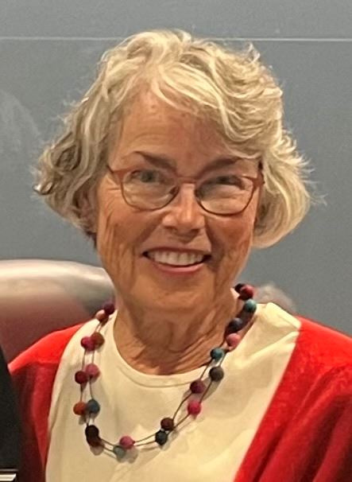
WELCOME
Teresa Onoda
Artist
Mayor of Moraga

Slide 5
Ekphrasis 2024 Artist and Authors
Adrienne Rogers
Alfred J. Garrotto
Andrew Dodd
Anindita Basu
Ann Marie Katie
Anne Rabe
Annette Laurel Batchelor
Anonymous
Arlynn Bloom
Arthur Cabral
B. Lynn Goodwin
Barry Hampshire
Bela Watson
Bill Carmel
Brian Shea
Briana Van Den Broeck
Charleen Steen
Colleen Gonzalez
Cynthia Leonard
Cynthia Whitchurch
Dalia Alenka
Dave Manousos
Dina Bogan
Dinah McFarlane
Donna Arganbright
Dorothy “Dot” Edwards
Ebba Nevas
Elana O’Loskey
Elise Dirlam Ching
Elizbeth Kennen
Fran Cain
Helen Chu-Hirschberg
Jane Martin
Jane Russell
Jennifer Granat
Jill Hedgecock
Jim Gunshinan
Joe Bologna
John A. Barry
John Nakanshi
Judith Feins
Judith Rohrer
Kaleo Ching
Kerima Swain
Lance Jackson
Linda Hartmann
Louise Moises
Mark Coffey
Margie Witt
Marlene Dotterer
Marylin Jia
Michael Barrington
Nannette Rundle Carroll
Nina Krebs
Ophelia Turner
Peter Dudley
Rachel Fite
Rosemary Therkelsen
Ruth Stanton
Salman Ansari
Samantha McNally
Sarah Vickers
Senait Mesfin Piccigallo
Sharon Tama
Stacy Spell
Stephanie Denman
Stephanie Rickman

Slide 6
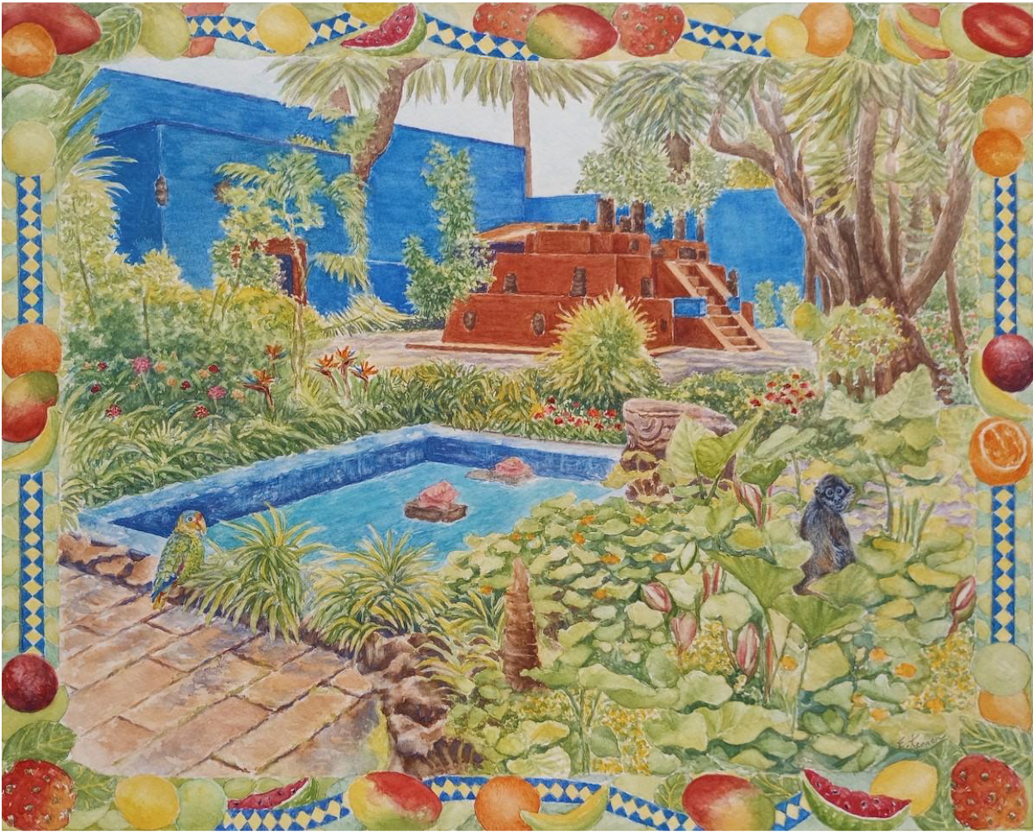
Frida Kahlo’s Garden
Artist: Elizabeth Kennen
Lamorinda Arts Alliance
Watercolor
20"x 24", framed

Slide 7
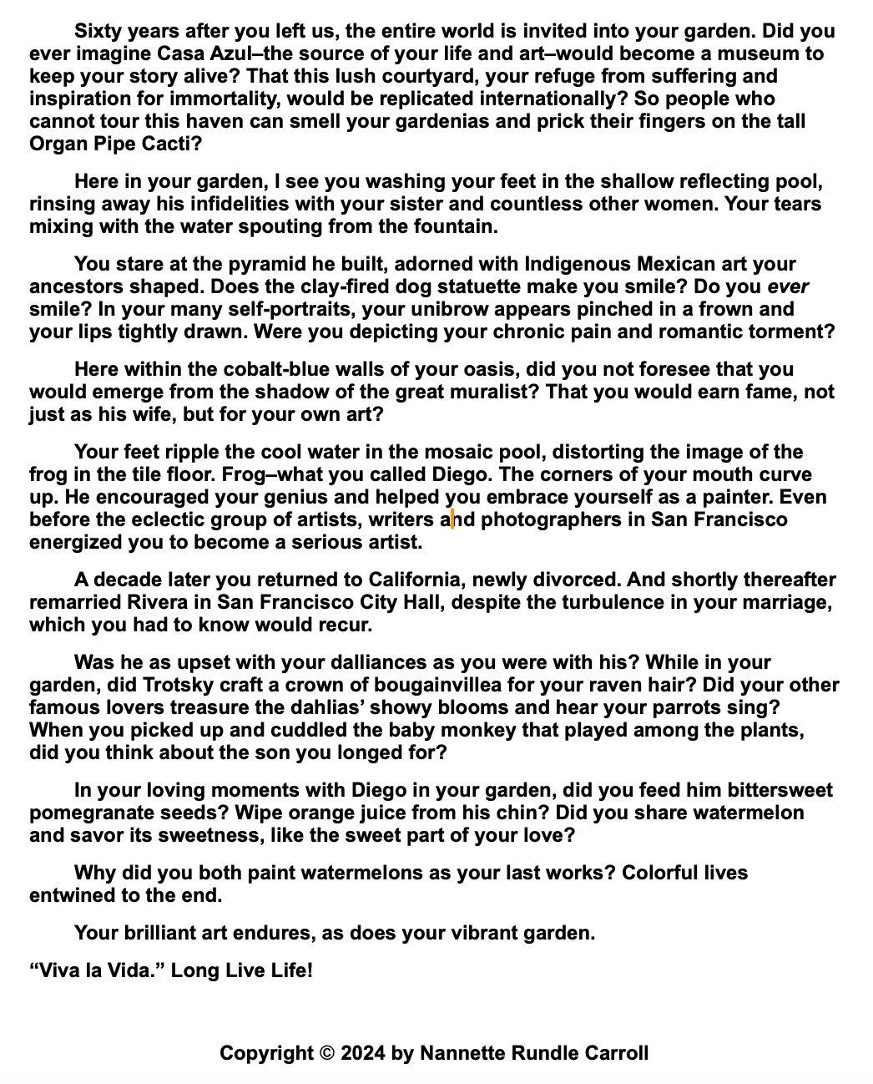
Frida Kahlo’s Garden
Author: Nanette Rundle Carroll
*Read Today by David George
California Writers Club, Mt. Diablo
1

Slide 8
Frida Kahlo’s Garden
Author: Nanette Rundle Carroll
California Writers Club, Mt. Diablo
2

Slide 9
Frida Kahlo’s Garden
Author: Nanette Rundle Carroll
California Writers Club, Mt. Diablo
3

Slide 10
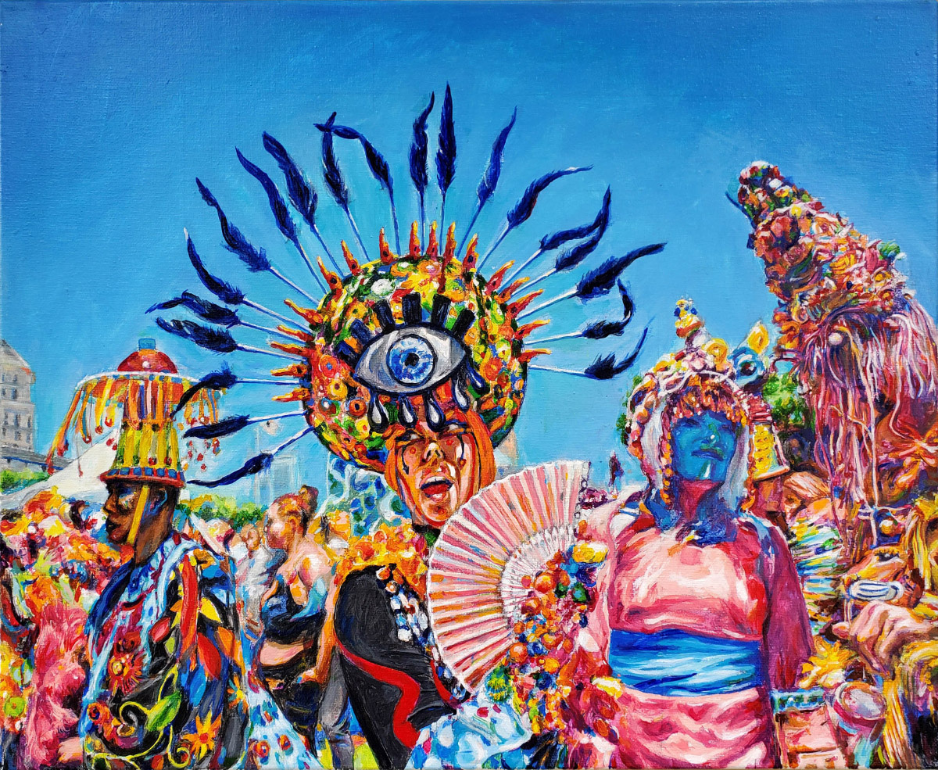
Verasphere, small
Artist: Lance Jackson
Lamorinda Arts Council
Acrylic on Canvas

Slide 11
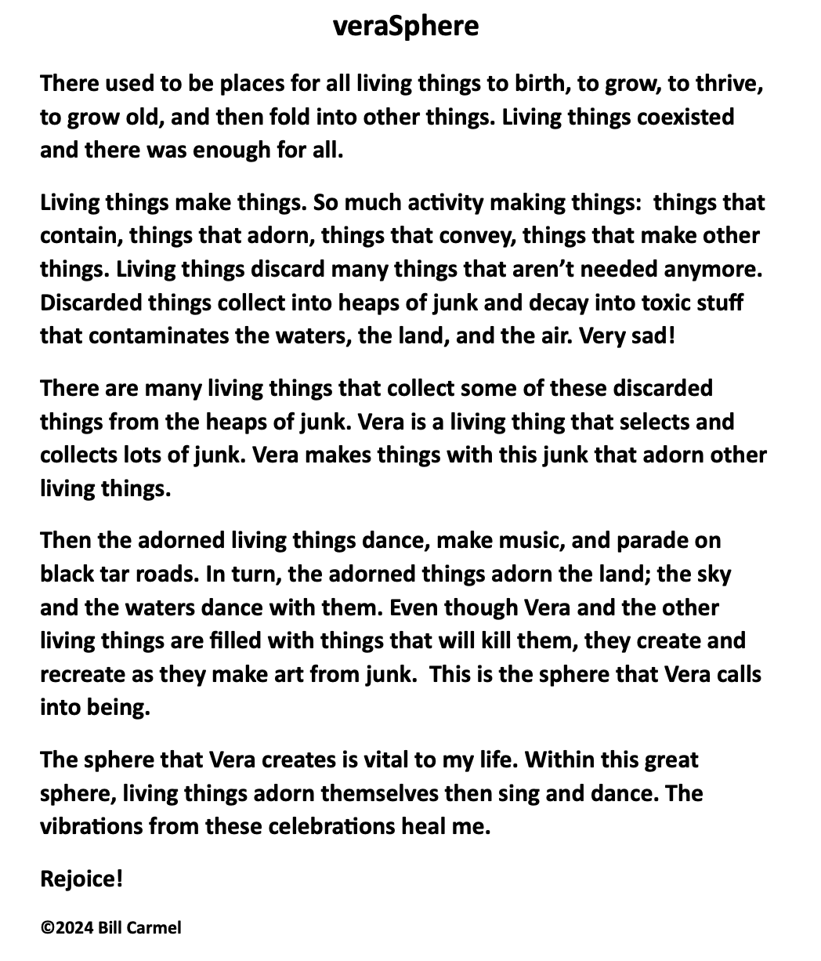
VeraSphere
Author: Bill Carmel
Lamorinda Arts Council
1

Slide 12
VeraSphere
Author: Bill Carmel
Lamorinda Arts Council
2

Slide 13
VeraSphere
Author: Bill Carmel
Lamorinda Arts Council
3

Slide 14
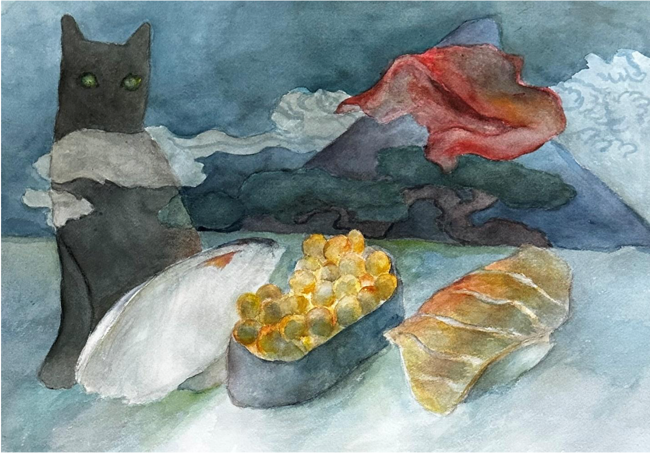
Sushi Dream
Artist: Helen Chu-Hirschberg
Lamorinda Arts Alliance
Watercolor
20" x 24", framed

Slide 15
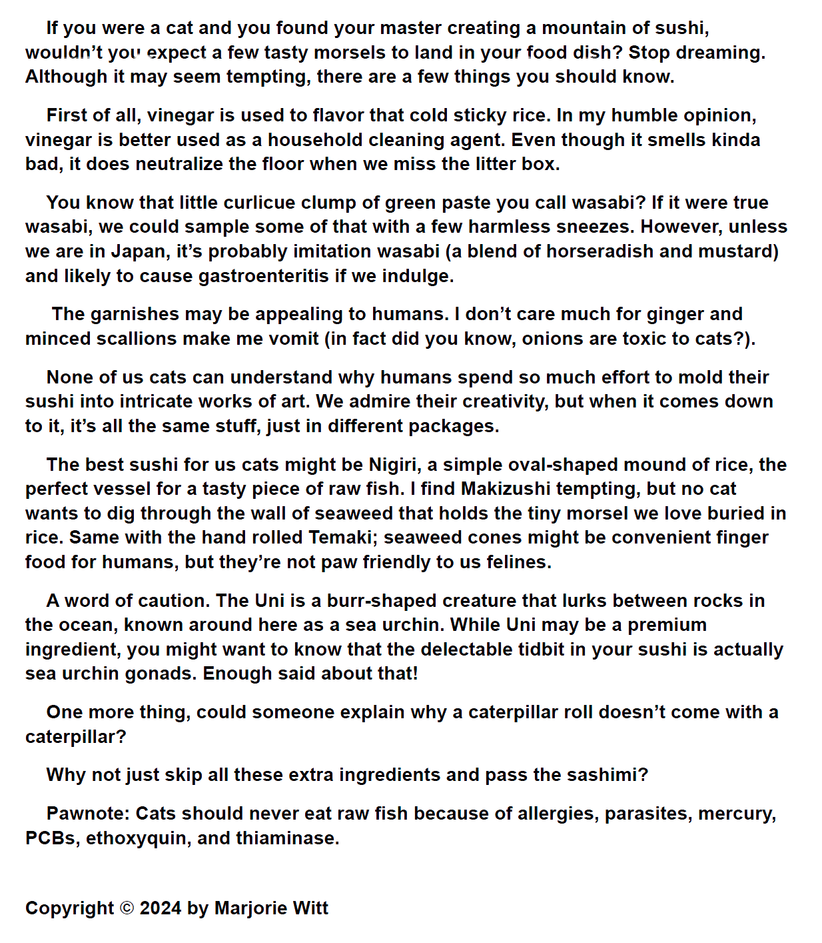
A Word of Warning
Author: Margie Witt
California Writers Club, Mt. Diablo
1

Slide 16
A Word of Warning
Author: Margie Witt
California Writers Club, Mt. Diablo
2

Slide 17
A Word of Warning
Author: Margie Witt
California Writers Club, Mt. Diablo
3

Slide 18


Special Thanks!
SMC, Art Intern LAC
Audio Visual
Skyla Loffland
Matthew Wakerling
Volunteers
Community Partners
Elana O’Loskey
Jingo Darlene Milo
Josephine Salbolboro
Kathy Molloy
Ramon Milo
Stanford Stewart
All Board Members of LAC, CWC & LAA

Slide 19


Slide 20
Thank you for coming!
Please join us on the Patio for an Artist Reception...
Ekphrasis Committee
Bill Carmel,
LAC Board Member & Curator
Linda Hartmann,
CWC Immediate Past President & Ekphrasis Chair
Ruth Stanton,
LAA Board Member & V.P. Exhibitions

